Slide 1
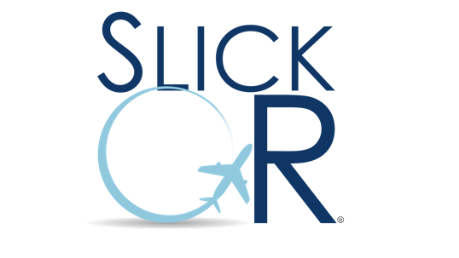
IROPs Recovery Optimization Solutions
Aircraft ATC programs passengers gates

Slide 2
About SlickOR
Founded in 2013, based in Austin, Texas
Focused on innovative optimized planning and recovery solutions
Current Focus
Holistic solutions
Robust Alerting
Data integration from multiple data sources
Cost and KPI Reporting
Better solutions. Premium service. Best pricing.
“United took multiple hits from major storms last year, including Hurricane Harvey …. Yet United had fewer cancellations in 2017 than it has ever had,
says Greg Hart, COO”¹

Slide 3
Our Products
Optimization and situational awareness solutions:
ATC Slot Optimizer
Aircraft Recovery Optimizer
Passenger Recovery Optimizer
Gate Planning Optimizer
Gate Recovery Optimizer
Crew Rules Alert Dashboard
Better solutions. Premium service. Best pricing.
Aircraft Recovery Optimizer
$10m
$3m
Gate Recovery Optimizer
$12m
ATC Slot Optimizer
Yearly savings for a large carrier

Slide 5
What’s Next
Holistic Solution to Network and Passenger Recovery
Solve the aircraft recovery problem and…
Minimize disrupted passengers’ delay minutes to the final destination
Adding proactive alerting capabilities
Crew alerting based on crew rules
“Before [Aircraft Recovery Optimizer], we probably canceled more flights than we needed to….
The new tool identifies the best flights to cancel that will disrupt the operation the least...”¹
--VP Network Operations Center

Slide 6
Who is a Good Fit
If you are an airline…
Looking for best-of-breed recovery solution
With flexible implementation options
Proven in production
If you are a vendor…
Looking to fill the recovery gap
Embed our core engine in your system
Or leverage our stand-alone solution
Better solutions. Premium service. Best pricing.
900
GDPs per year
15%
Reduction in passenger delay minutes
25%
Improvement in passenger connections
$12m
Yearly Savings

Slide 7
Q&A
Take Control of Operational Disruptions
Thank you!
Rex Bull, CMO
Rex.Bull@SlickOR.com
512.633.8314
Kevin Gibson, Director Products
Kevin.Gibson@SlickOR.com
512.806.6767
“United took multiple hits from major storms last year, including Hurricane Harvey …. Yet United had fewer cancellations in 2017 than it has ever had,
says Greg Hart, COO”¹

